Slide 1
Symbol Table

Slide 2
Purpose of the course
To create a simple compiler
As a first step, we are going to implement a symbol table

Slide 3
What is symbol table?
A symbol-table is a data structure maintained by compilers in order to store information about the occurrence of various entities such as identifiers, objects, function names etc.
Information of different entities may include type, value, scope etc.
At the starting phase of constructing a compiler, we will not go into many detail. We will simply construct a symbol-table based on hashing where collision is resolved by chaining.

Slide 4
Symbol Table
Stores information about the entire source program.
It is used by all phases of a compiler (We will learn about the phases of a compiler in the theory class)

Slide 5
Symbol Table
Symbol table will be used to answer two questions:
Given a use of a name, to which declaration does it correspond or is it undeclared?
Given a declaration of a name, is it multiply declared?

Slide 6
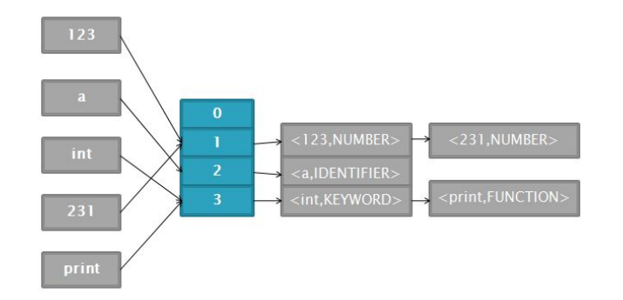

Slide 7
Hash table
foo FUNCTION
i IDENTIFIER
123 NUMBER
<= RELOP
How to insert them on table?
Need a hash function
Find the hash for that particular name
It can be done in various ways

Slide 8
A simple way to get a key
Add the ascii value of the each character present in the name
Then divide the sum by the size of the table(you will predefine the size of it)
Then you can use the remainder as key

Slide 9
Calculation for 123
Ascii value of 1= 49, 2= 50, 3=51
49+50+51 = 150
Let the size of table is 7
Then, key = 150%7 = 3
123 will be in the row number of 3

Slide 10
What will be for others?
f : 102, o : 111
i : 105
< : 60, = : 61

Slide 11
What will happen if two value have the same key?
123 number
231 number
Both will have the same key!

Slide 12
What will we implement?
Class SymbolInfo
Storing information (name, type) about the symbol or token
Class SymbolTable
Since our symbol table will be a hash-table based on chaining, we will have to start with an array of pointers where each pointer points to a list of nodes of type class SymbolInfo

Slide 13
Methods of Symbol Table
insert(): to insert a new symbol along with its type into the symbol table
lookup(): to lookup whether a given symbol already exists in the symbol table or not

Slide 14
Sample Input
int KEYWORD
myFunction FUNCTION
x IDENTIFIER
111192019 NUMBER
( PARENTHESIS

Slide 15
Code Sample
Will be given to you
You have to add necessary things to get the desired output

